Slide 1
Reflective and reflexive teaching
By, MelAnie taylor, Ashlie cook, and Jordan hall
We recognize that we are life long learners
We can resonate with this topic more than ever right now because we are student teachers who are constantly needing to reflect upon our unit plans and lesson plans and make changes. We need to be reflexive teachers because it’s one thing to recognize changes that need to be made, but it’s another to be able to put those changes into practice.
With our unprecedented current situation we have had to be reflexive in what our expectations are, our outcomes and what is to come in the upcoming weeks and months for us as newly trained educators.

Slide 2
Practicum outline
Ashlie: kindergarten at Heritage Elementary
Jordan: grade two at Hart Highlands Elementary
Melanie: grade five/six at Springwood Elementary
Here we will introduce ourselves as teacher candidates and explain where and what grade we taught.

Slide 3
What does it mean to be reflexive and reflective?
Reflective: being able to self-assess one’s own pedagogy and strengths, but more importantly, aspects of ones teaching that could be improved and how those areas can be improved.
Reflexive: educators can implement the changes or improvements to their teaching practice right away. You can take your reflections, self-assessments and evaluations that you have observed in yourself and transfer that into making changes in your teaching practice.
One of the teacher candidates will explain what it means to be a reflective and reflexive teacher. The teacher candidate will make sure they emphasis (once definitions are explained) that in order to truly show a cohesive relationship between reflective and reflexive practice you must be able to exhibit both concepts in your practice.

Slide 4
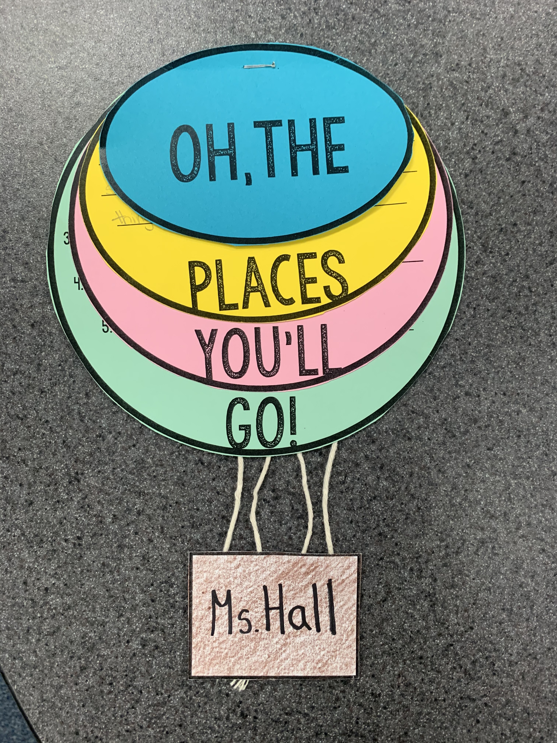
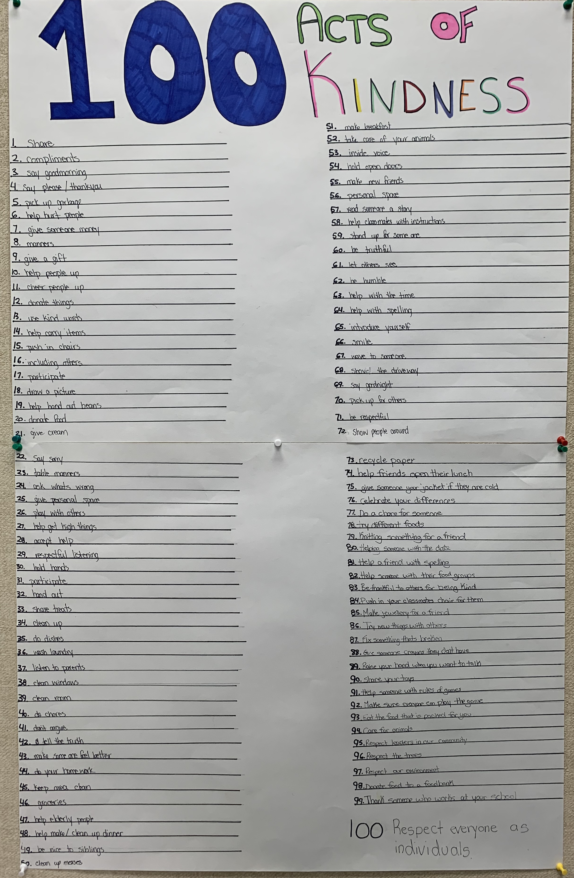
Practicing Reflective and Reflexive teaching- Jordan
Reflective vs. reflexive- these two concepts go hand in hand, one must be reflective in order to be reflexive along their journey
Reflective and reflexive principles practiced during Education 491 practicum:
Behavior management tools
Routines
Unit planning
Lesson plans and outcomes
Lesson development before and during the lesson
Communication with coaching teacher and Practicum mentor after lesson
Daily reflection on on how the day progressed
Single point rubric analysis
Unprecedented ending to Education 491- adaptions, reflection and reflexive practice exemplified
For this slide I will make sure I discuss how I personally practiced reflective and reflexive teaching in my education 491 practicum. To begin I want to share with my fellow classmates and colleagues that in order for me to be a reflexive educator I had to be reflective. All of the changes I personally made, may it be lesson plans, unit plans, lessons on the fly, daily activities, and assessment all came from reflecting on what went well and what could have been improved. Embarking on this particular education journey was an exhilarating yet “scary” task. When you are the one planning all of the lessons, the day and the entire 10 weeks you are in the classroom there are a lot of questions and risks to be taken. I found that by becoming a reflective person I could grow from all of these experiences in the 10 (8 ) weeks we were given for practicum and that every experience was a learning opportunity. I was always looking for feedback not only from myself but from my coaching teacher and my co-teacher who I spent a tremendous amount of time with. This feedback was always constructive and really allowed me to look at something from a completely new perspective. Now I could not feel satisfied with this reflective behavior if I did not show reflexives(ness) and embody these evaluations in my teachings going forward. I believe this style of learning and teacher allows the teacher to always remain humble and grateful for feedback, and to always be learning. Our educational journey is only beginning and I am thrilled to say that every point made on this slide I am still learning and asking questions about.

Slide 5
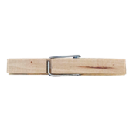
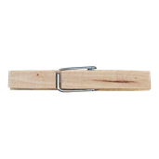
Melanie
Classroom management was a struggle and the system in place was not working for me
I reflected with the principal after school one day and she suggested I try a rewards system as opposed to a punitive system
Came up with a rewards system that built on the existing punitive system and implemented it the next day
Students had a choice of how to behave and management became easier for the rest of my practicum.
Spark Champion
At the beginning of my practicum, I was feeling defeated by the management aspect of my practice. The behaviour management system in place was a three strikes and your out system. There was a chart listing the classroom expectations. If a student did not adhere to the expectations, a clothes pin with their name on it was put on the ledge of the white board. If they continued to not follow expectations, their clothes pin moved to a chart on the board. The third time they did not follow expectations, they were asked to fill out a Think Sheet, their parents were notified and I filled out an office referral. After a few weeks of using this system, I felt like the students were not responding well. After school, one day the principal came in to ask how I was doing. We reflected together on her experiences and my experiences and she suggested I try a rewards system. As I drove home after school, I came up with the idea of a Spark Champion. I wanted to build on the system that was already in place. The next day I implemented my new system, when a student exhibited classroom expectations, I would move their clothes pin to the Spark Champion poster on the board. If they exhibited expectations three times before lunch, their name went on a Spark Card and into a bin. At the end of the week, I drew two names out of my bin and those two people received a prize. This worked very well for me for the rest of my practicum.
I wanted to make this more anecdotal but in the interest of time (even though that is not an issue anymore) you can read the full anecdote in my e-portfolio.

Slide 6
How was I a reflexive and reflective teacher? - Ashlie
Being reflexive and reflective educators ensures us of being life long learners.
How were these principles practiced throughout my practicum?
~ Unit planning
~ lesson planning
~ assessment
~ Communication with coaching teacher, practicum mentor and parents
~ Routines
~ Daily self-reflection
~ Behaviour management
My journey is beginning! I will continue to practice being a reflexive and reflective educator.
I want to discuss how every day I have to be reflexive and reflective in the above points. Unit planning was the area where I needed to be the most reflective, which is what I would spend the most time talking about.To start my final practicum I had to create 4 different unit plans before even starting practicum, and before getting to know my students. I went into practicum thinking I had a clear idea to how these units would go. I would be wrong. The day I started teaching those students, was the day I realized my unit plans were not going to work for these kids. If I was not willing to practice being a reflective educator, those students would not have learned or enjoyed a thing I was going to teach them. I would then be showing I did not have those students best interests at heart. Every day those students surprised me and they challenged me. Every day I sat down and debriefed with my coaching teacher, and everyday I implemented changes that she thought would be best. That shows that I was able to practice being a reflective and reflexive student teacher.

Slide 7
Conclusion
We are entering a profession where we will be learning every day.
Becoming an educator means you are prepared to be lifelong learners, just like your students!
Reflective practice in the teacher can be transmitted to reflective practices by students.
Be willing to change in your practice, it will save you grief in the long run!
One of the teacher candidates will briefly go over our concluding points.

